Slide 1
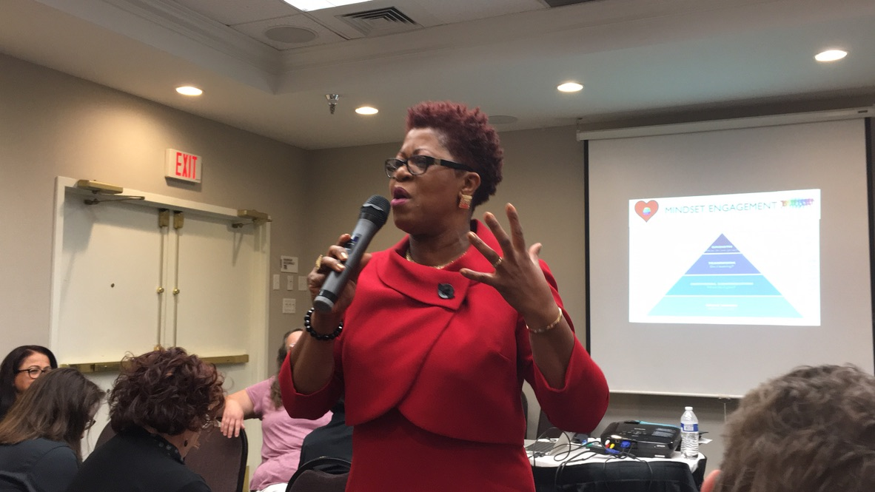

Slide 2
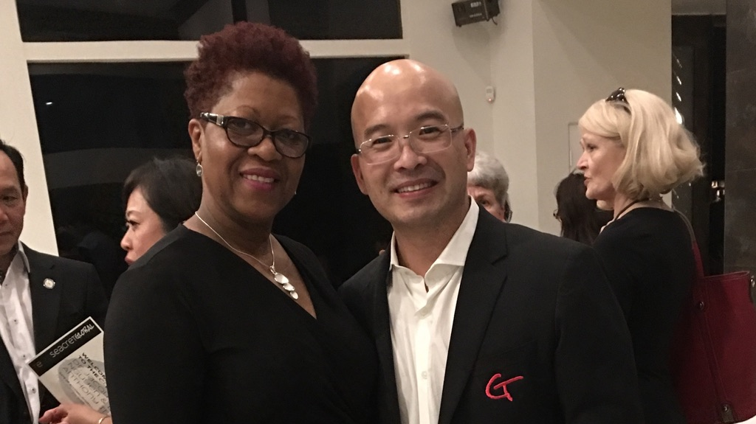
SEACRET Conference Speaker, Arizona

Slide 3
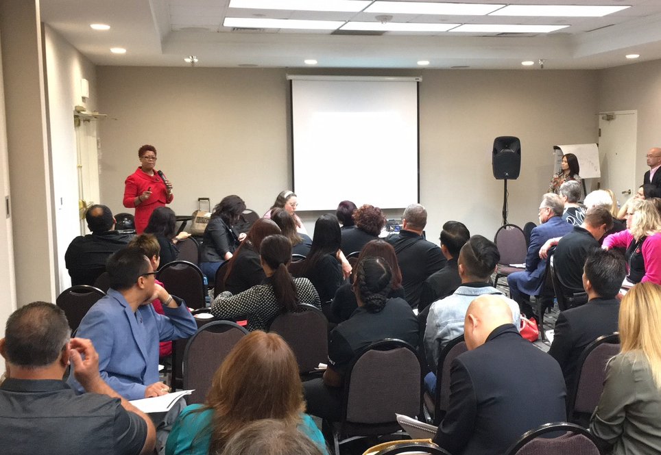
Guest Speaker Scotsdale, Arizona, USA

Slide 4
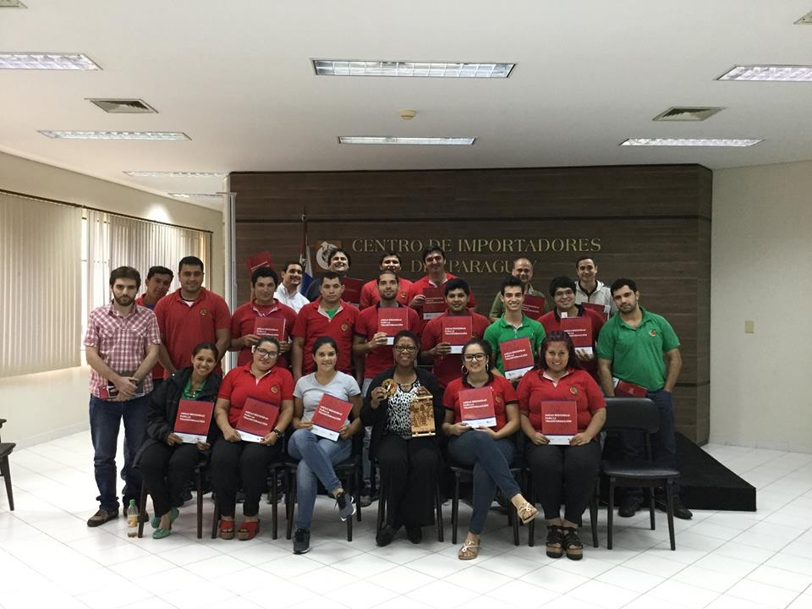
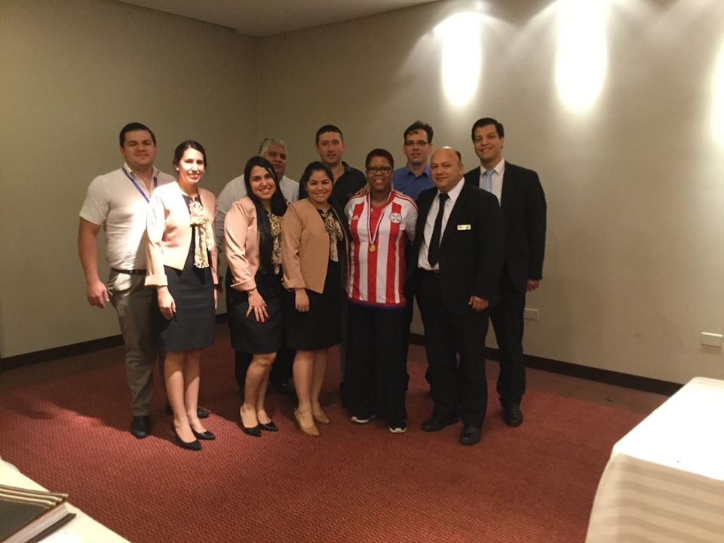
Leadership Coaching Paraguay, South America

Slide 5
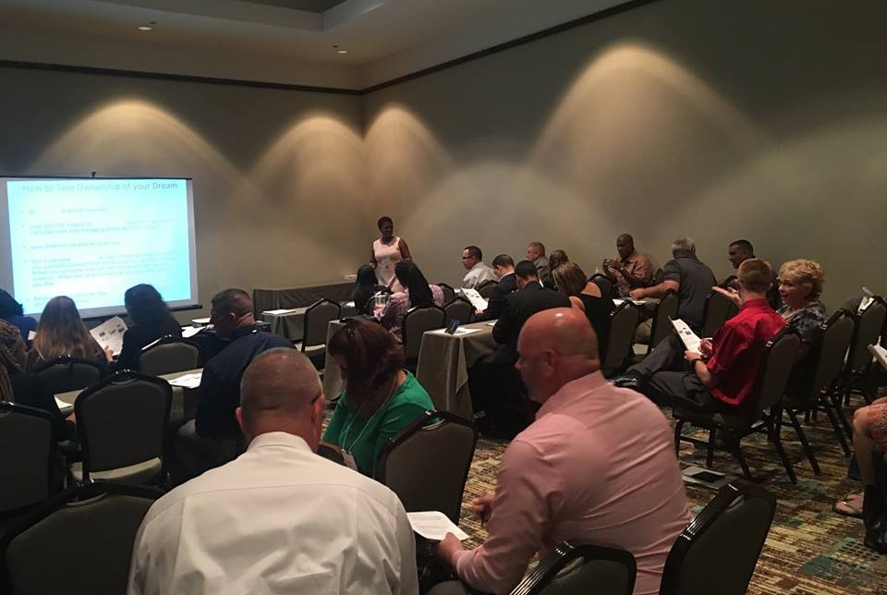
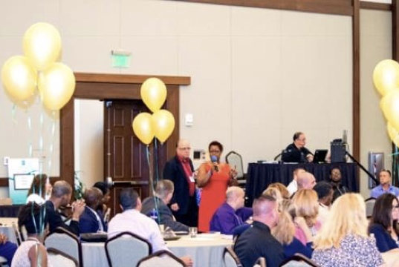
Guest Speaker on Employee Engagement Lake Buena Vista, FL, USA

Slide 6
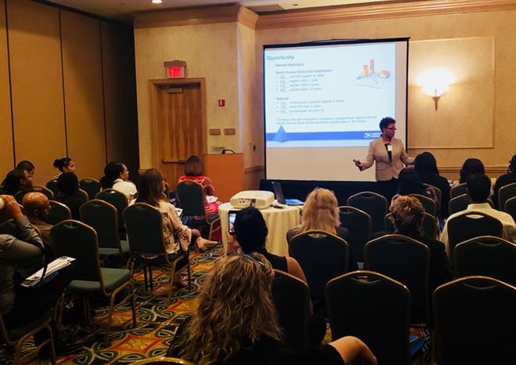
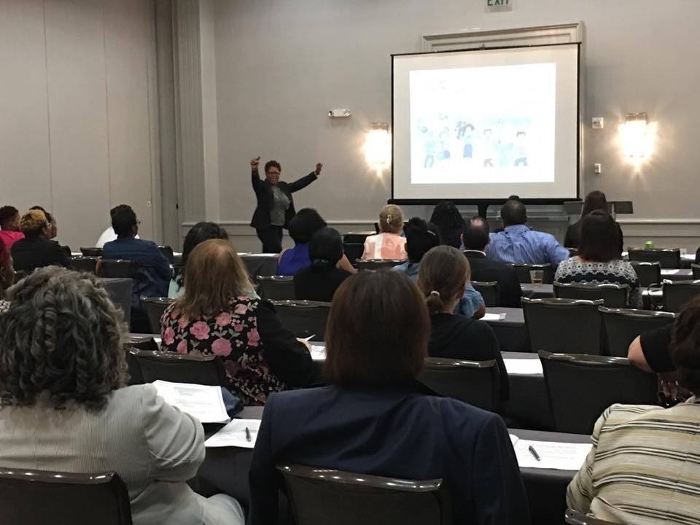
Leadership Workshop Lakeland, FL, USA

Slide 7
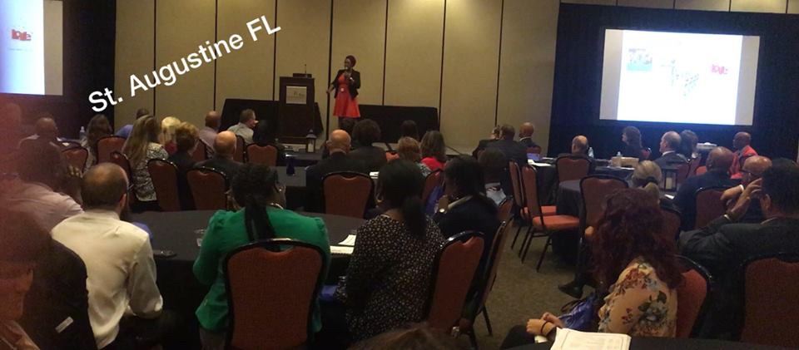

Slide 8
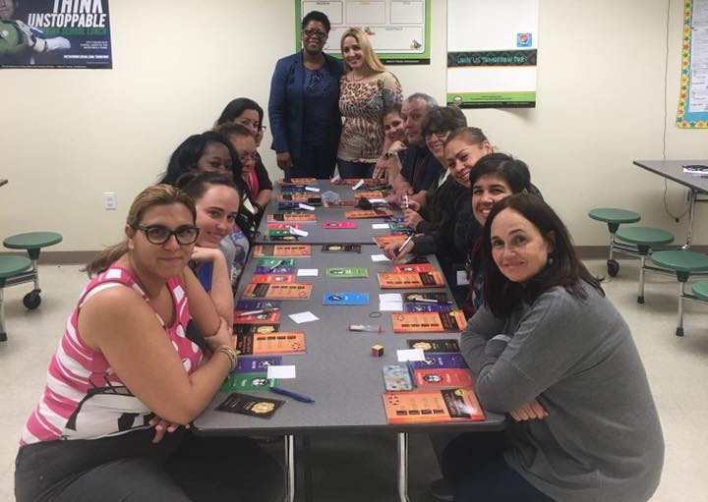
Leadership Game Experience Educators Professional Development Pembroke Pines, FL, USA

Slide 9
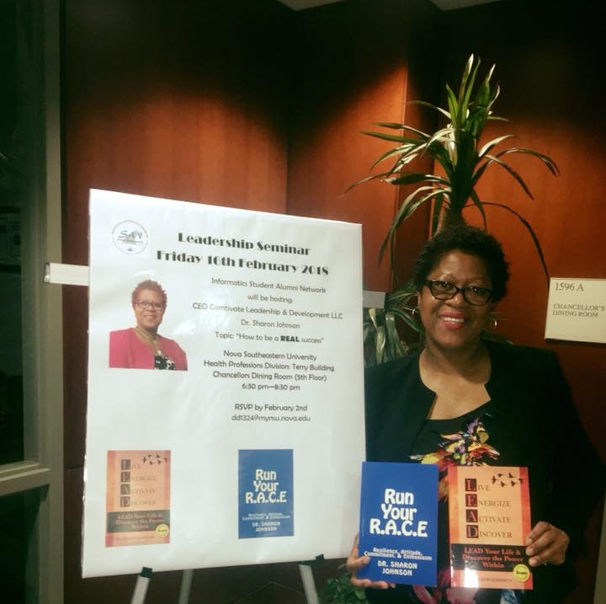
Nova University Speaker, FL, USA

Slide 10
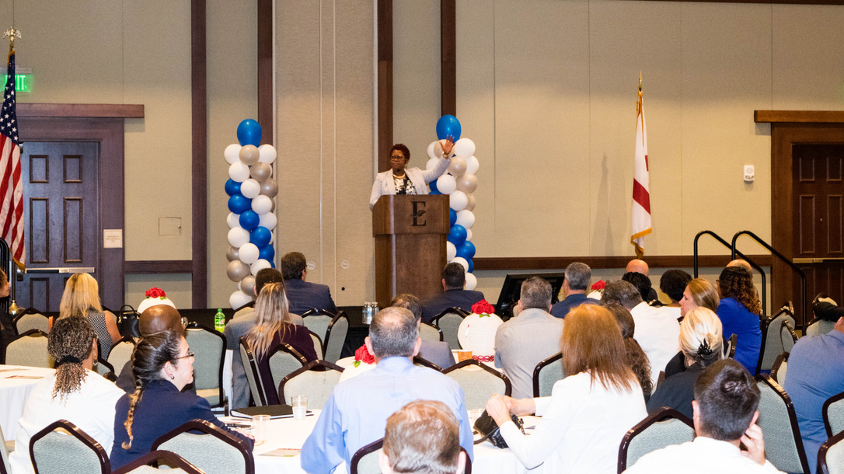
Orlando, FL USA

Slide 11
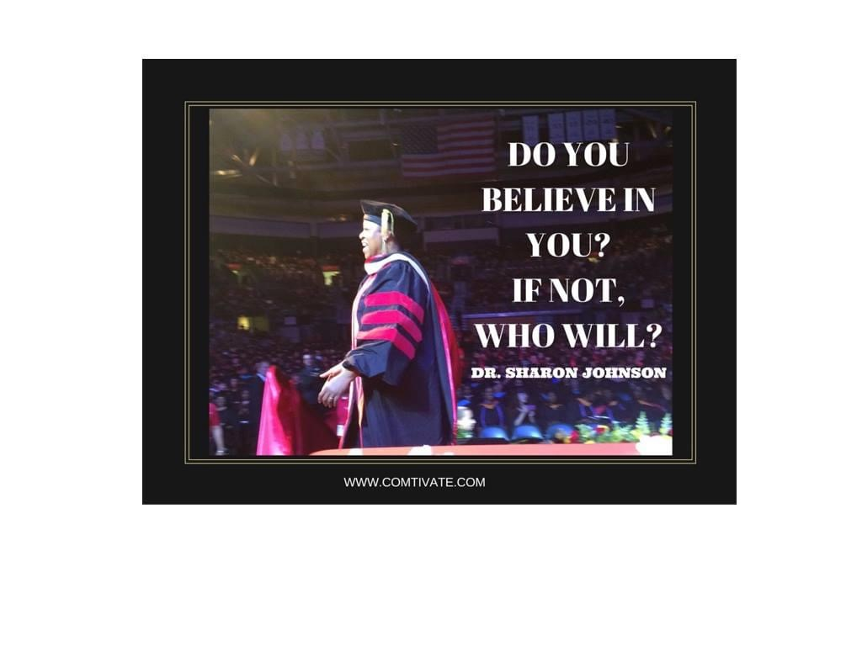
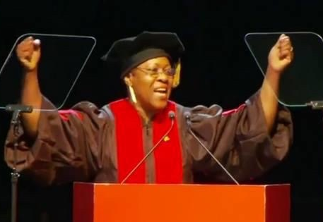
University of Phoenix, Student Speaker

Slide 12
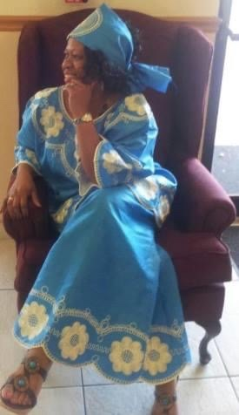
Black History Month Speaker FL, USA

Slide 13
National Association of Christian Women Entrepreneur (NACWE) Conference Speaker McKinney, TX, USA

Slide 14
Certified Dr. Sharon Johnson Comtivate LTD

Slide 15
Awarded to Dr. Sharon Johnson University of Phoenix, USA

Slide 16
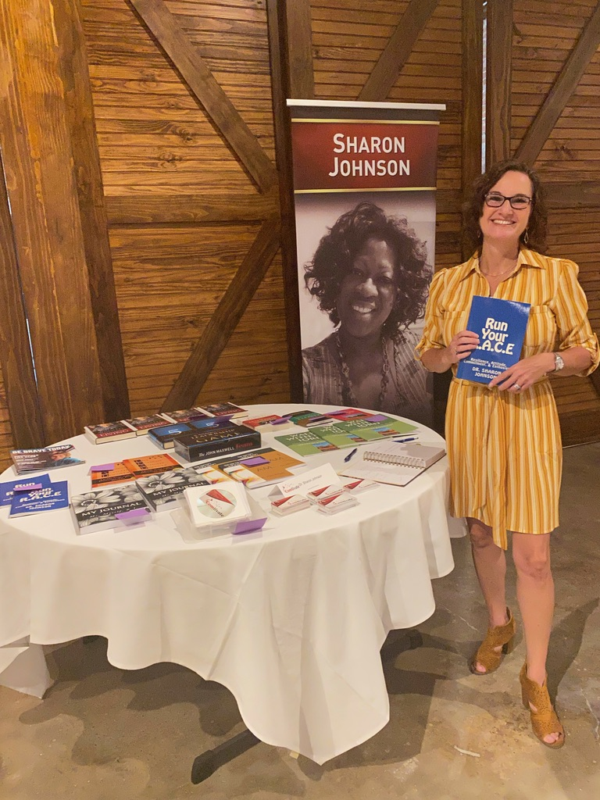
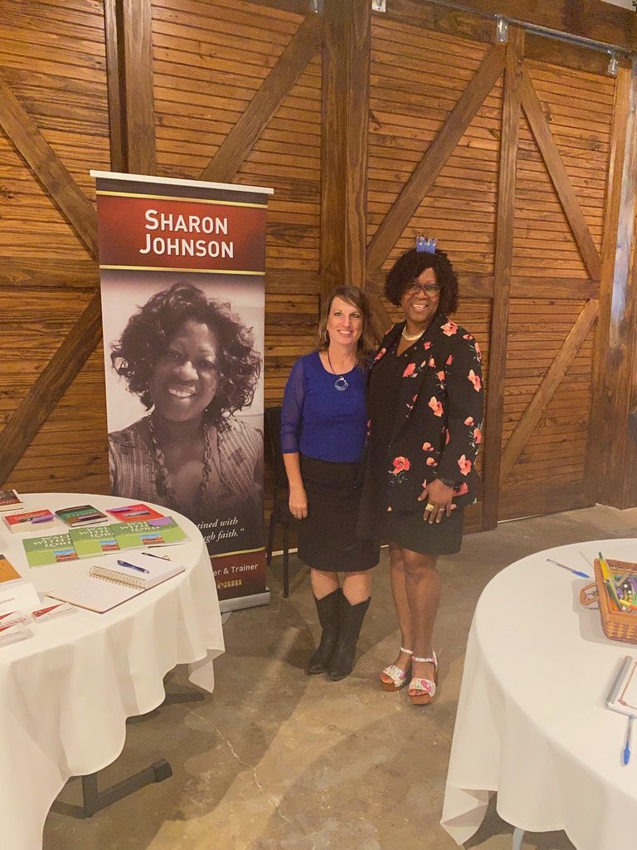
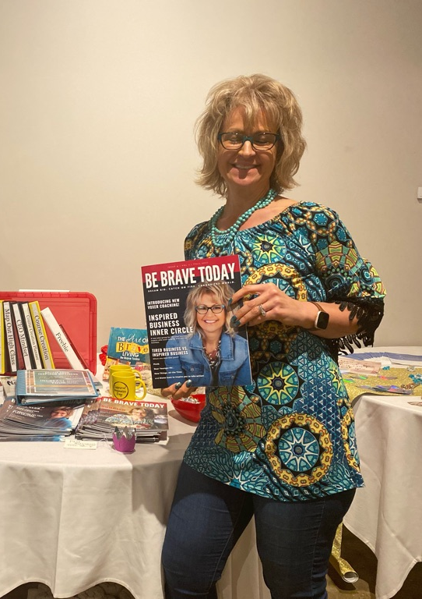
Conference Speaker, McKinney TX, USA

Slide 17
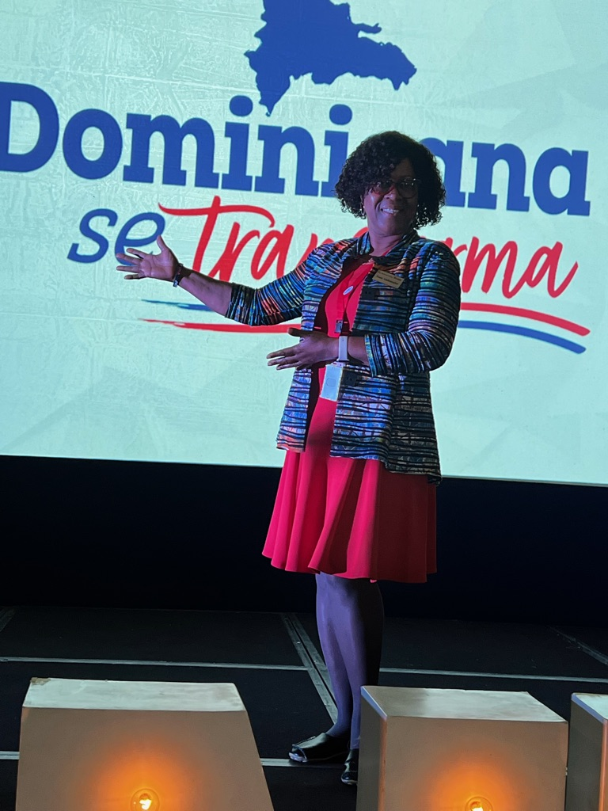
Leadership Coaching Santo Domingo Dominican Republic
FamilyID=Office_ArchiveTorn

Slide 18
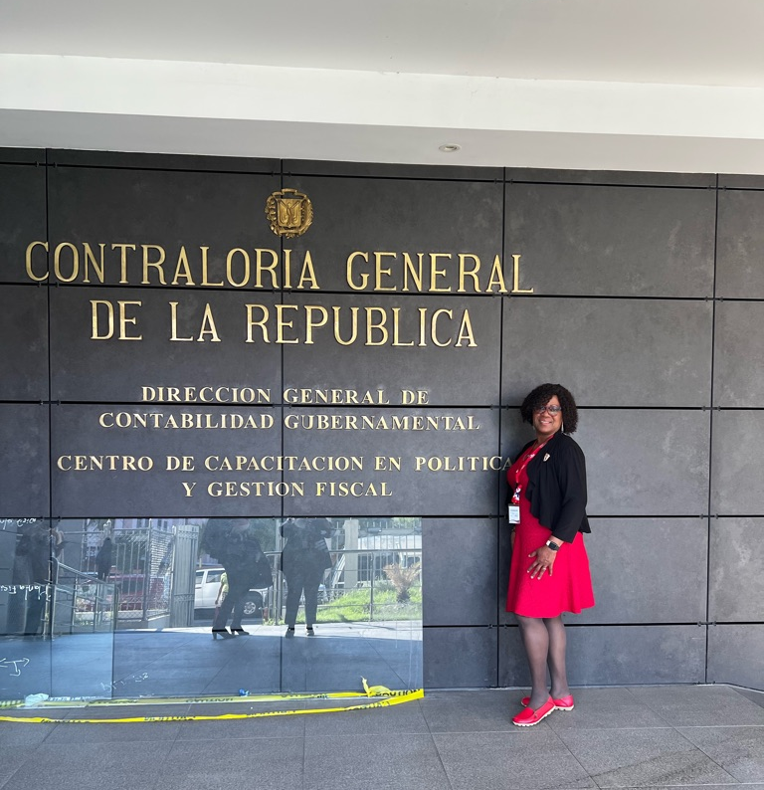
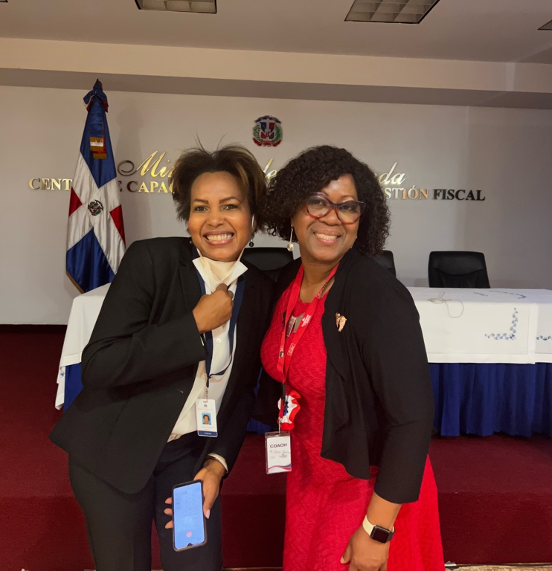
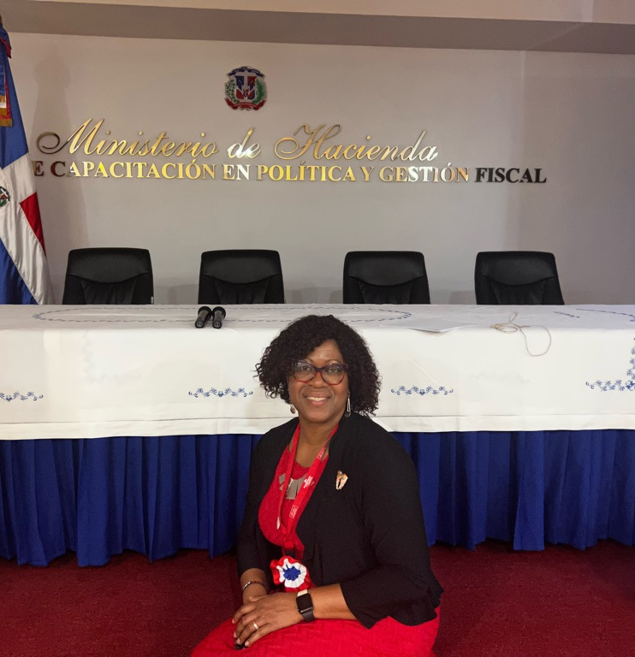
Leadership Coaching Santo Domingo, DR

Slide 19
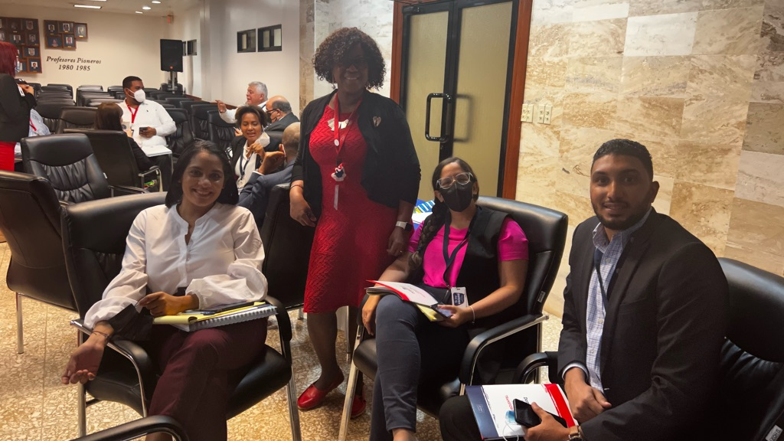
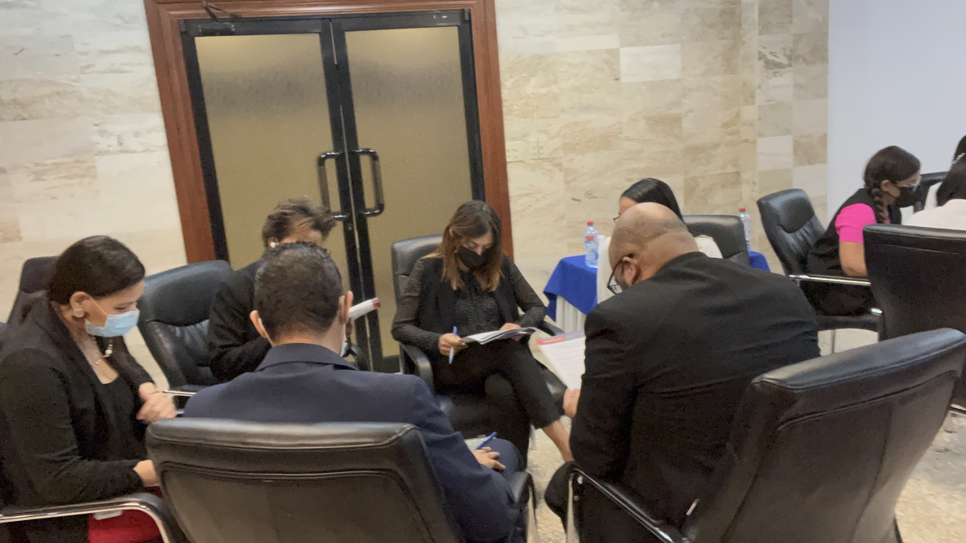
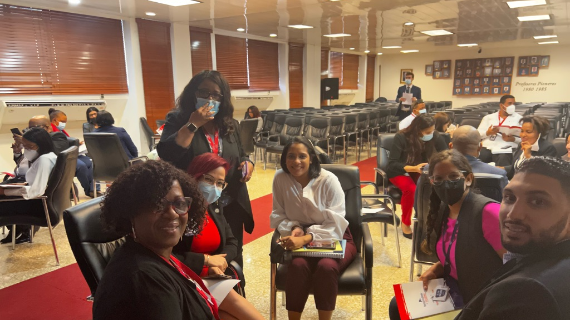
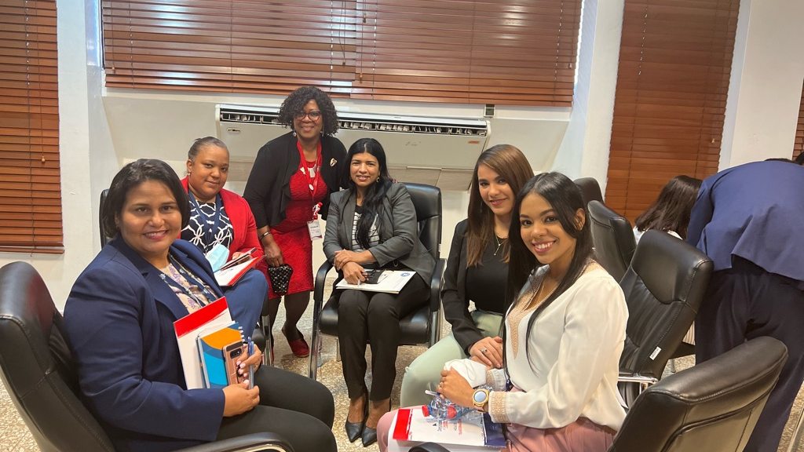
Coaching, Punta Cana Dominican Republic

Slide 20
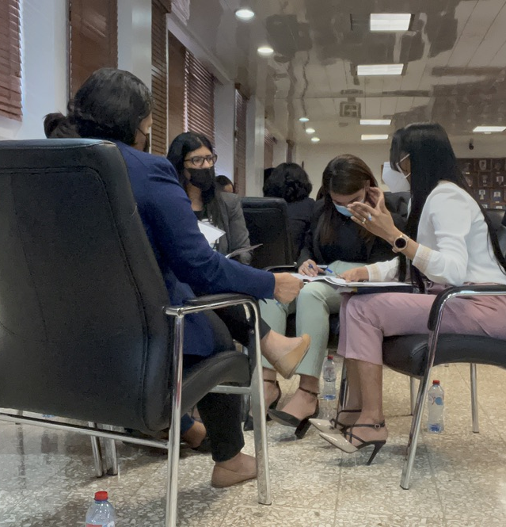
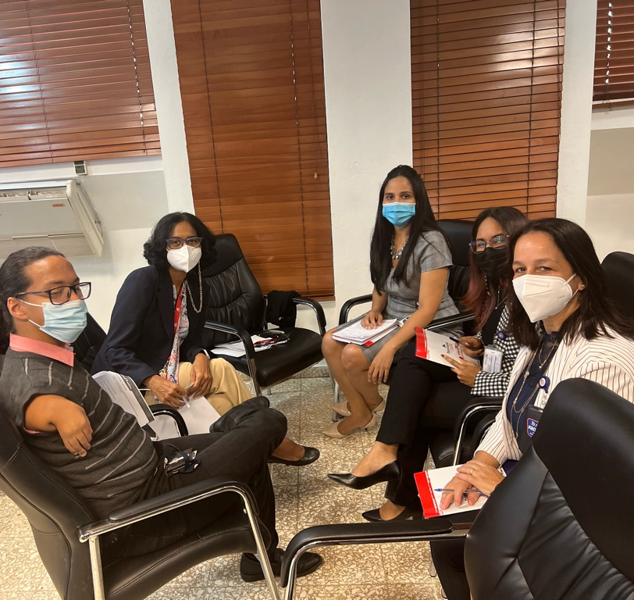
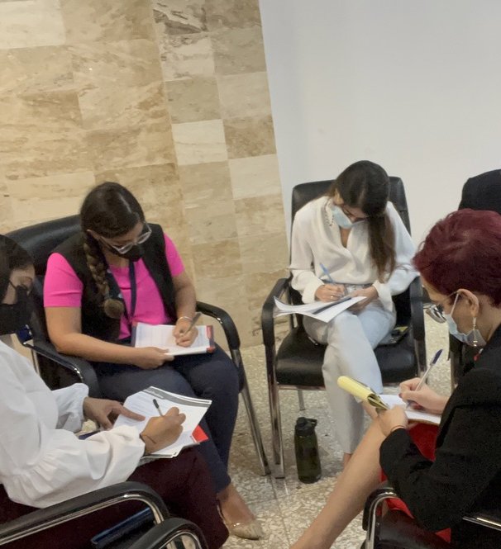
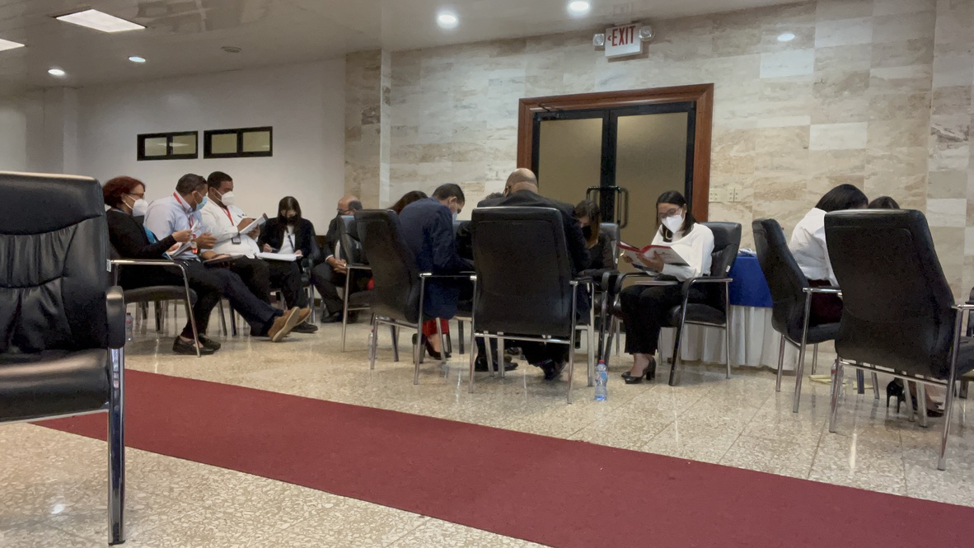
Punta Cana, Dominican Republic, South America

Slide 21
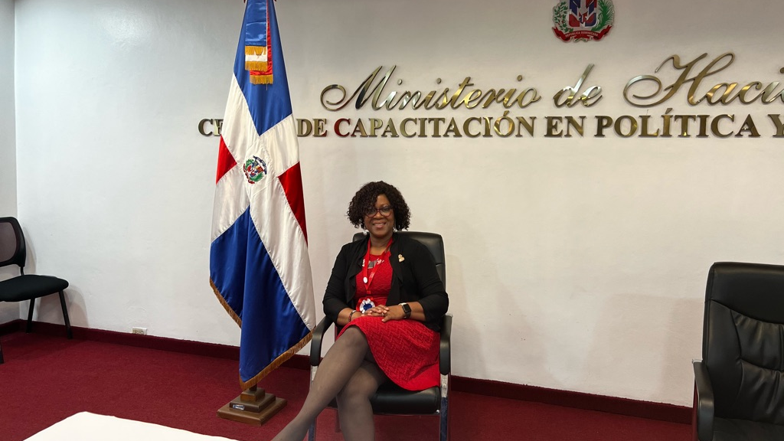
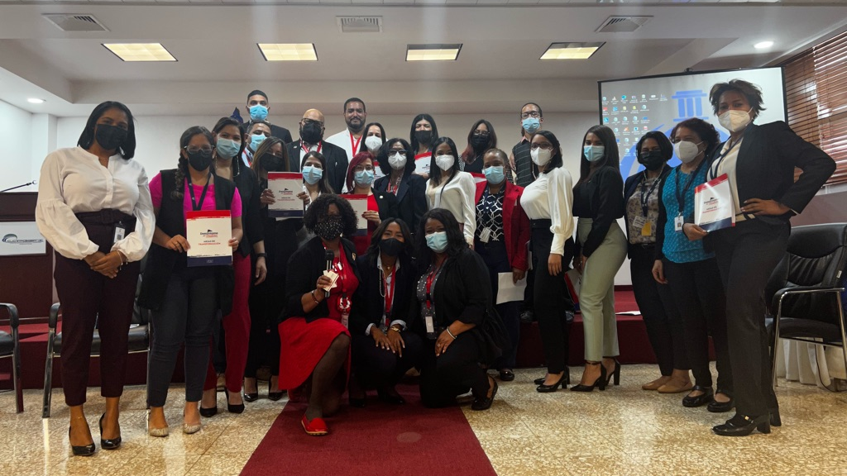
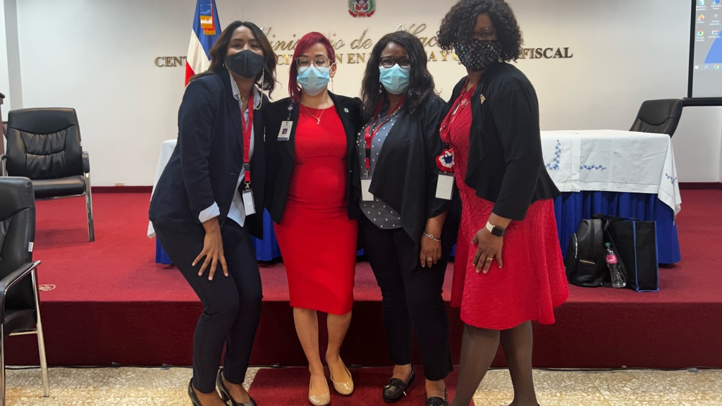
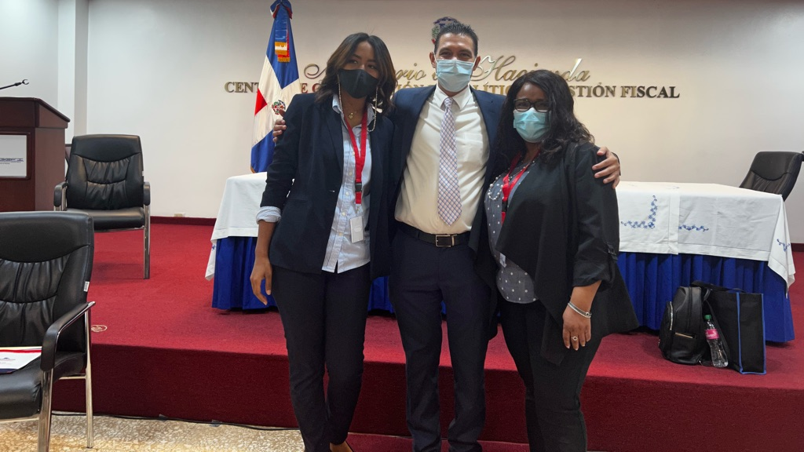
City Hall, Dominican Republic, South America

Slide 22
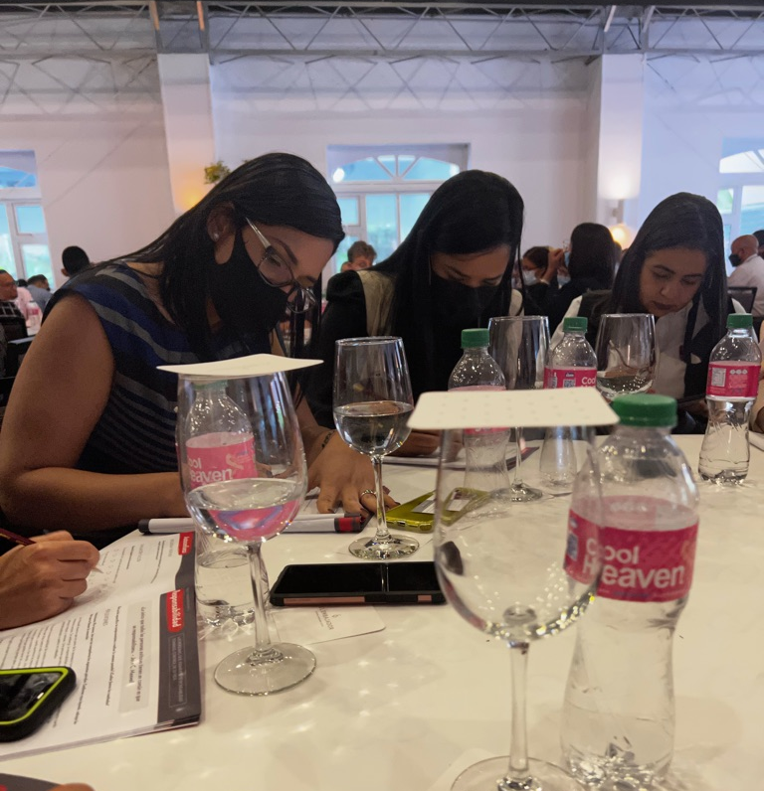
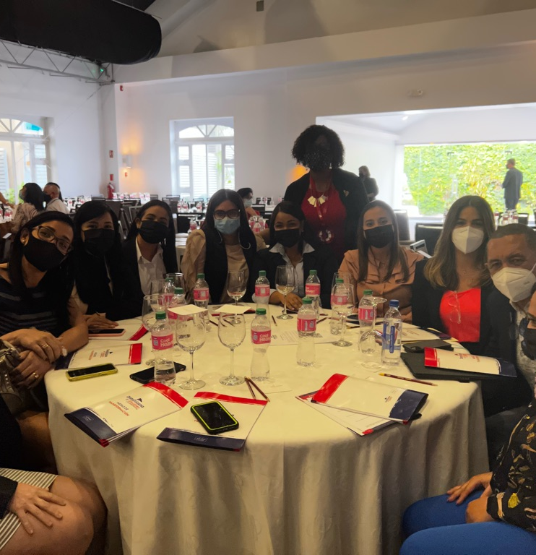
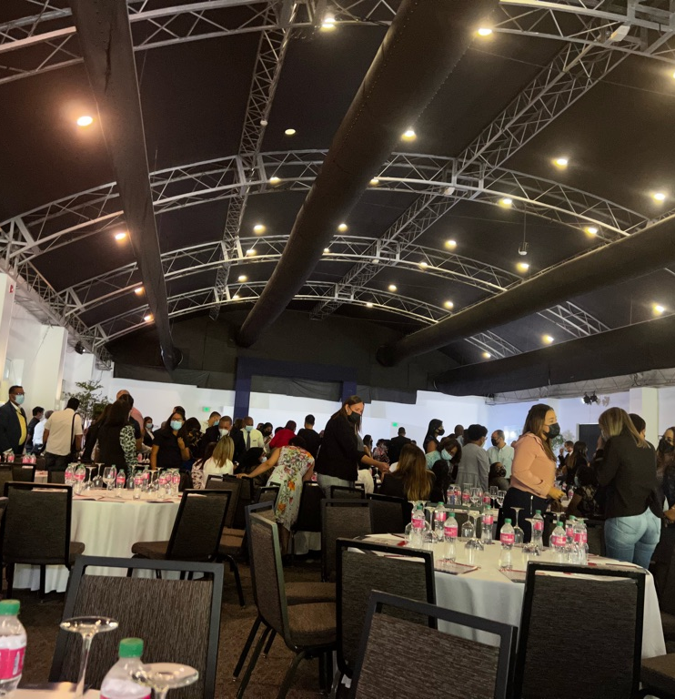
Leadership Tables, El Embajador, Dominican Republic, South America

Slide 23
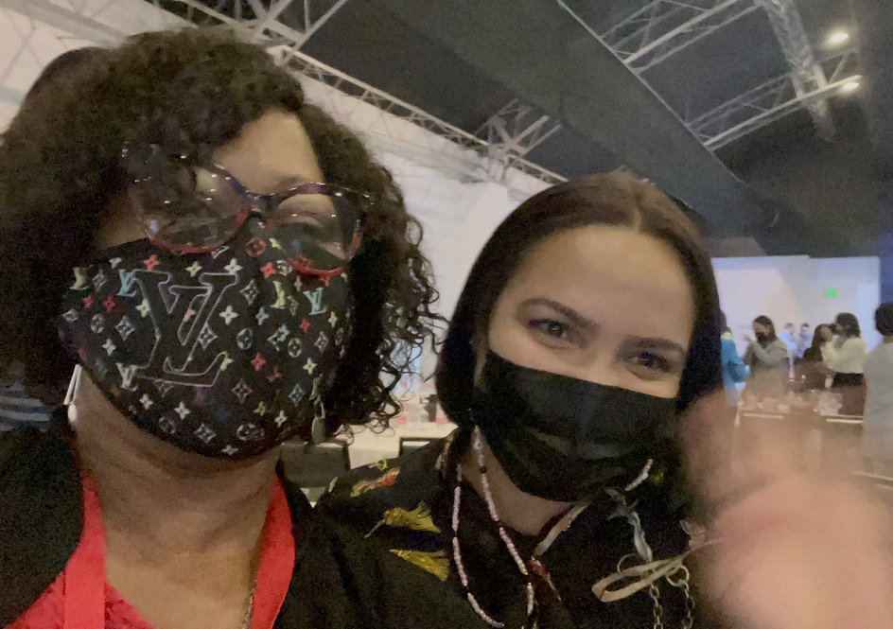
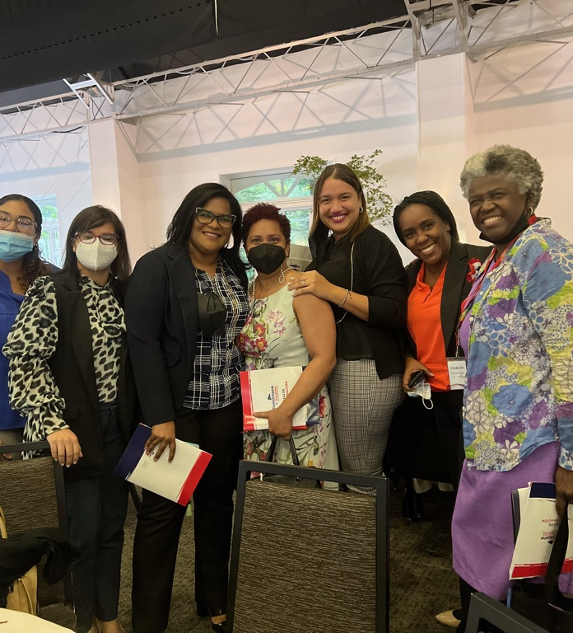
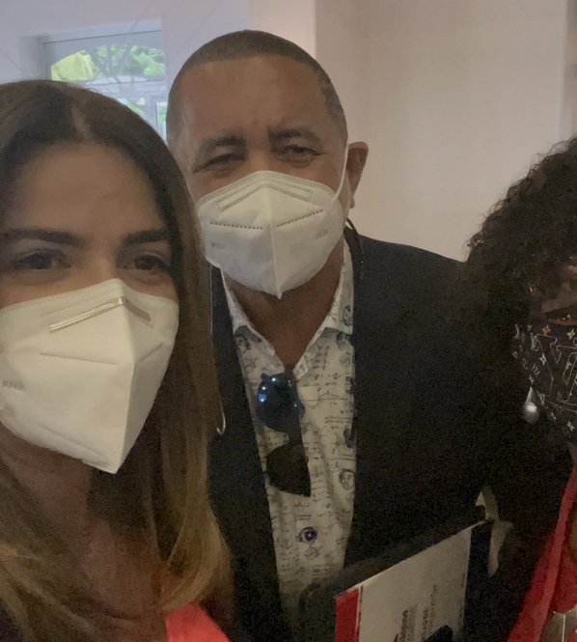
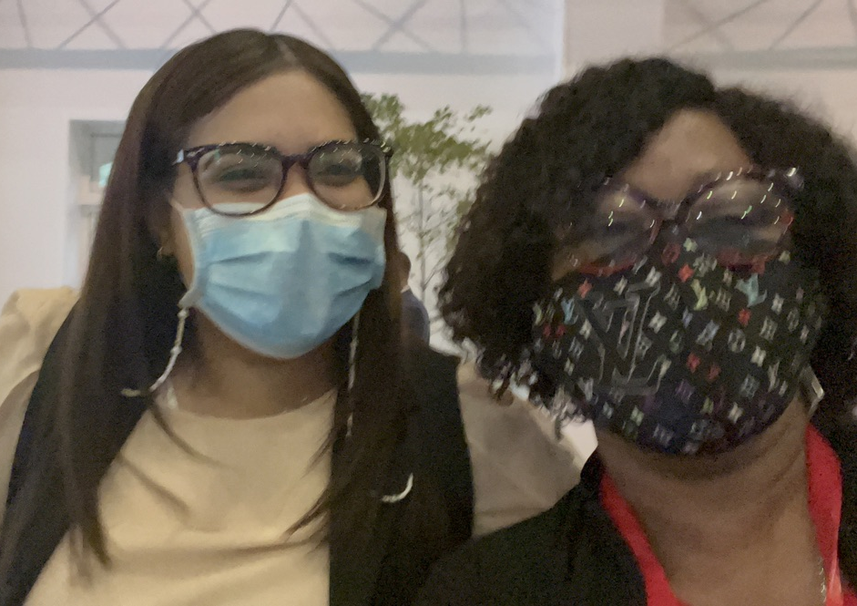
Santo Domingo, Dominican Republic

Slide 24
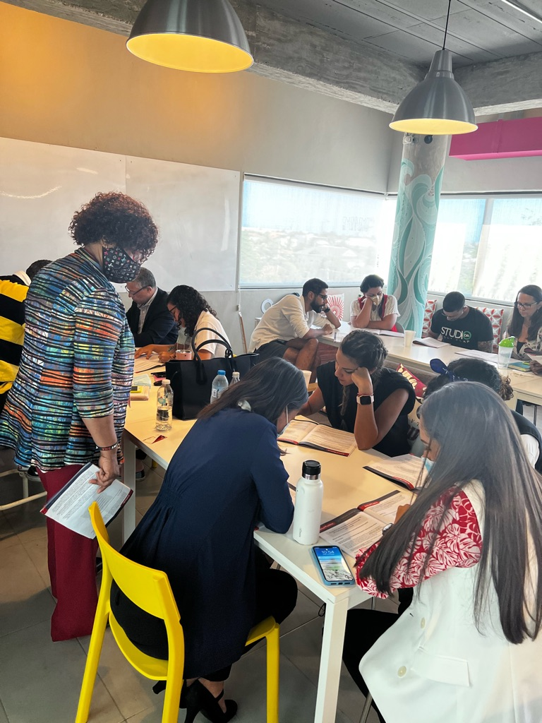
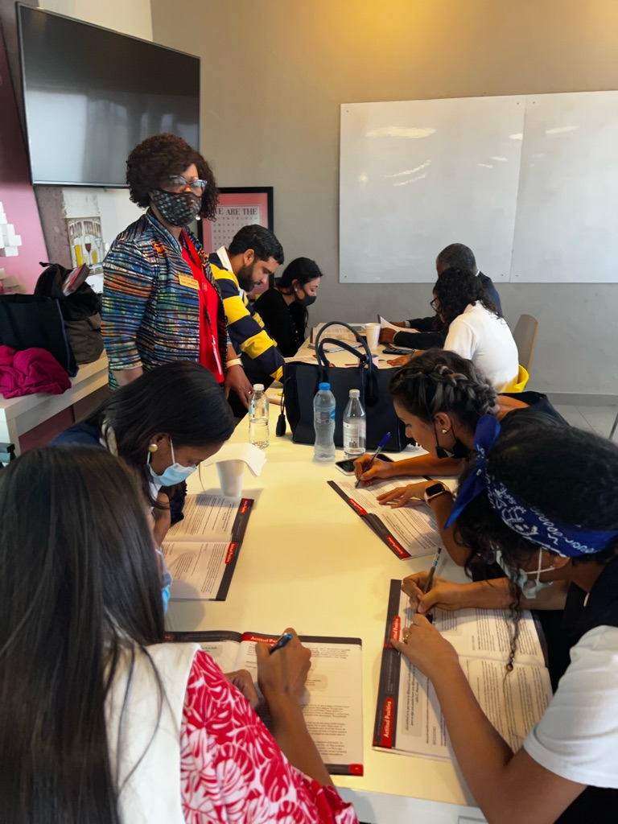
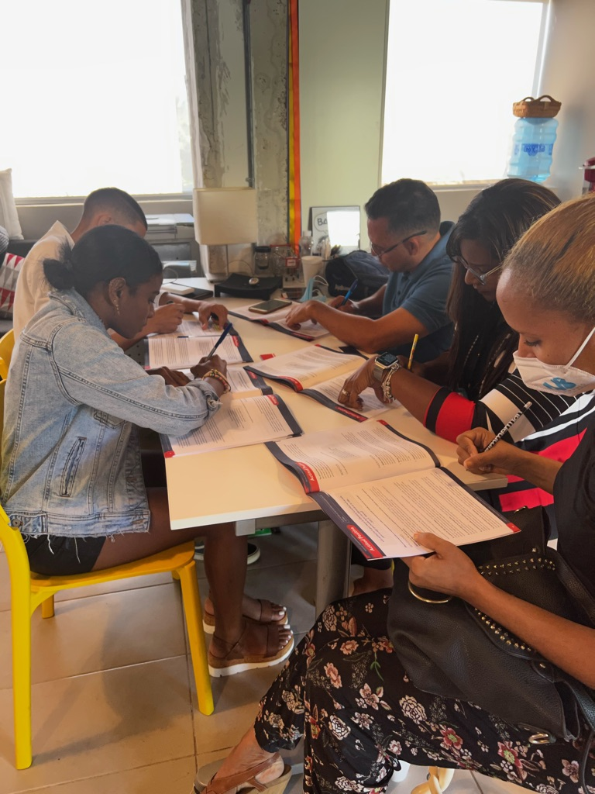
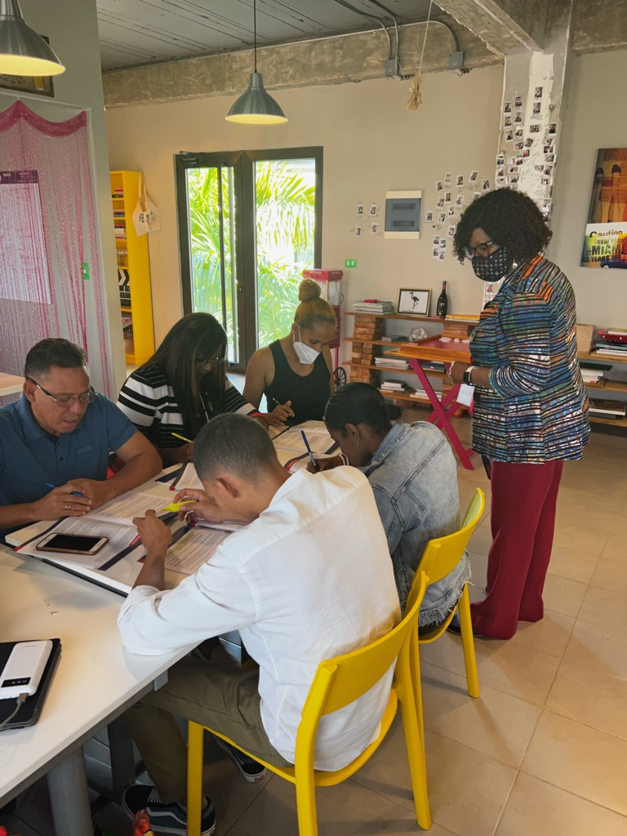
Records Office, Dominican Republic, South America

Slide 25
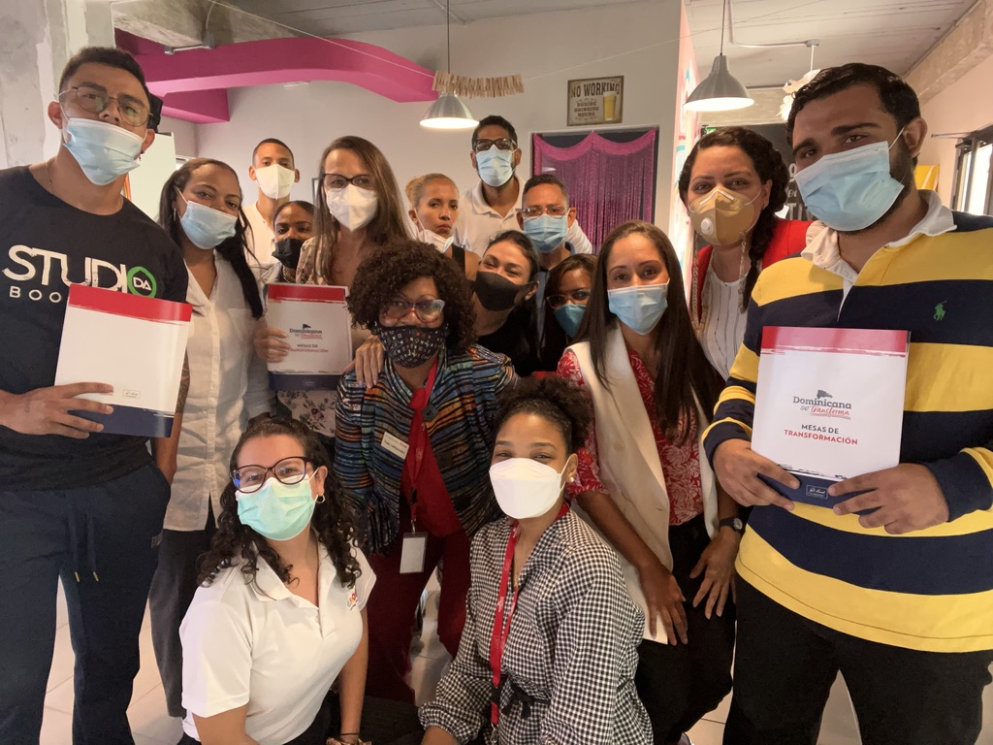
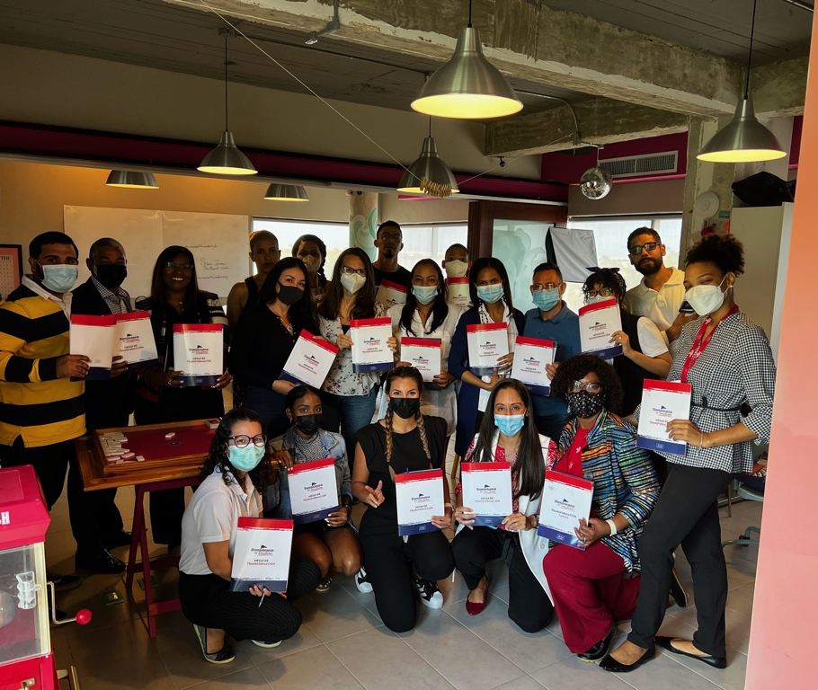
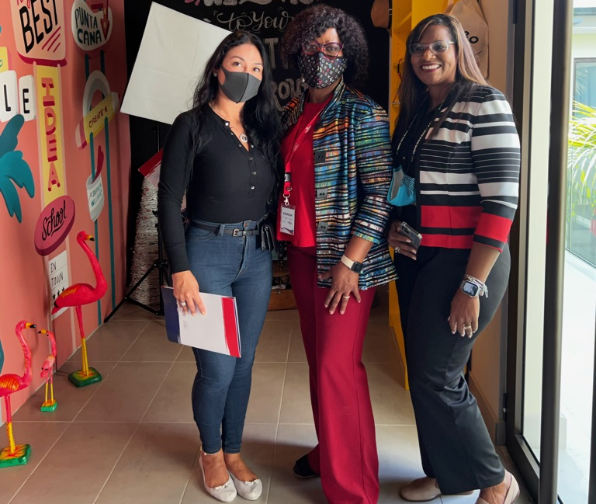
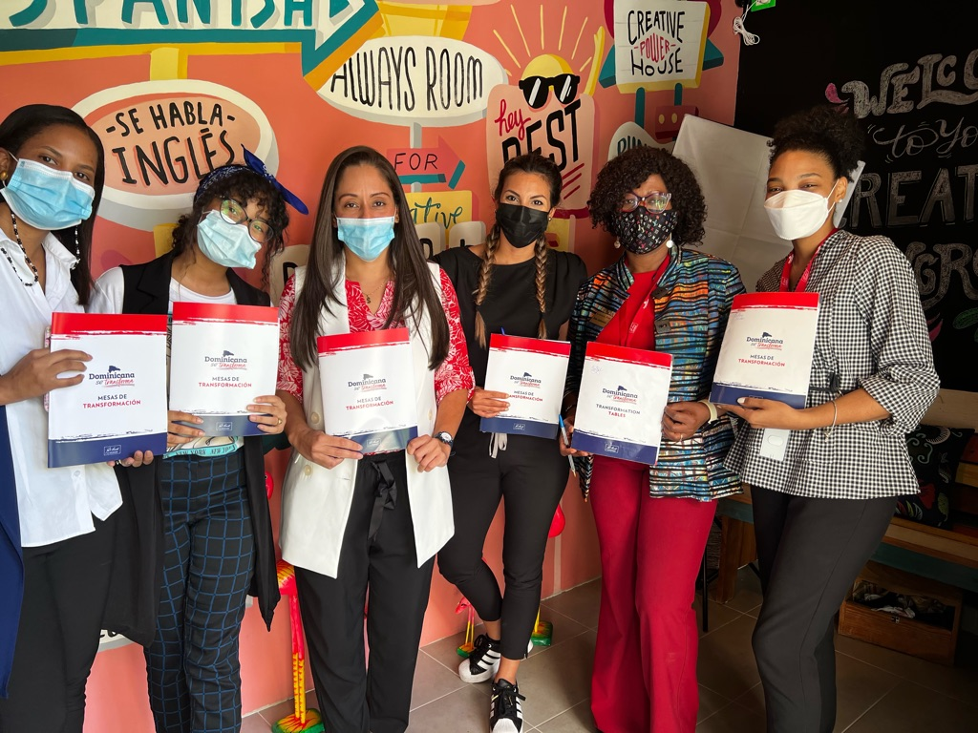
Medical Office, Punta Cana, DR, South America

Slide 26
Medical Office, Punta Cana, DR, South America

Slide 28
Coaching City Leaders, Punta Cana, Dominican Republic

Slide 29
Leadership Coaching, Santo Domingo Iglesia, Dominican Republic

Slide 31
Leadership Coaching with John Maxwell Dominican Republic

Slide 32
Nigerian Wedding Guest Speaker

Slide 33
Rotary Sunrise Club, TX, USA Rotary Youth Leadership Chairwoman

Slide 34
University of Phoenix Doctoral Student Speaker Award

Slide 35
Federal Award for Community Leadership

Slide 36
Guest Speaker, Nova University

Slide 37
Leadership Tables, DR, South America

Slide 38
Fort Lauderdale Nurses Conference

Slide 39
Conference Speaker Arkansas, USA

Slide 40
Veterans Speaker, Hollywood, FL, USA

Slide 41
Little Rock, USA Career Conference Keynote Speaker

Slide 42
Mississippi Career Conference Keynote Speaker

Slide 43
Employee Engagement Speaker, Alabama, USA

Slide 44
Orlando Conference Speaker , FL USA

Slide 45
Conference Speaker

